Slide 1
ENVIRONMENTAL MONITORING
USING Arduino

Slide 2
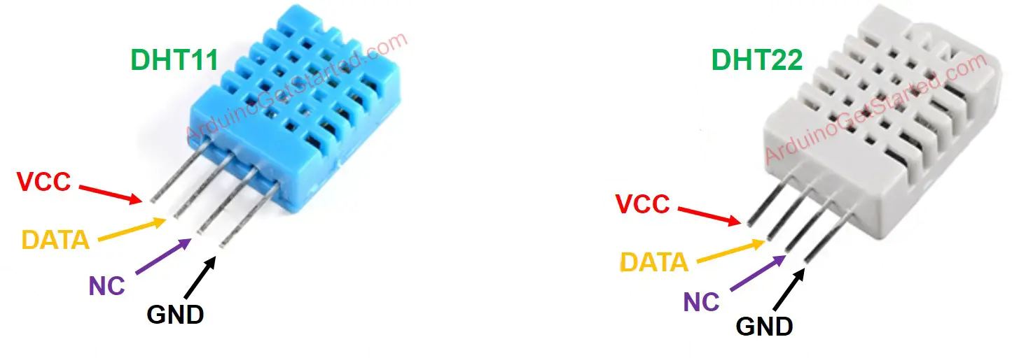
Pinout
DHT11 and DHT22 sensor in original form have four pins:
GND pin: Needs to be connected to GND (0V)
VCC pin: Needs to be connected to VCC(5V or 3.3V)
DATA pin: The pin is used to communicate between the sensor and Arduino

Slide 3
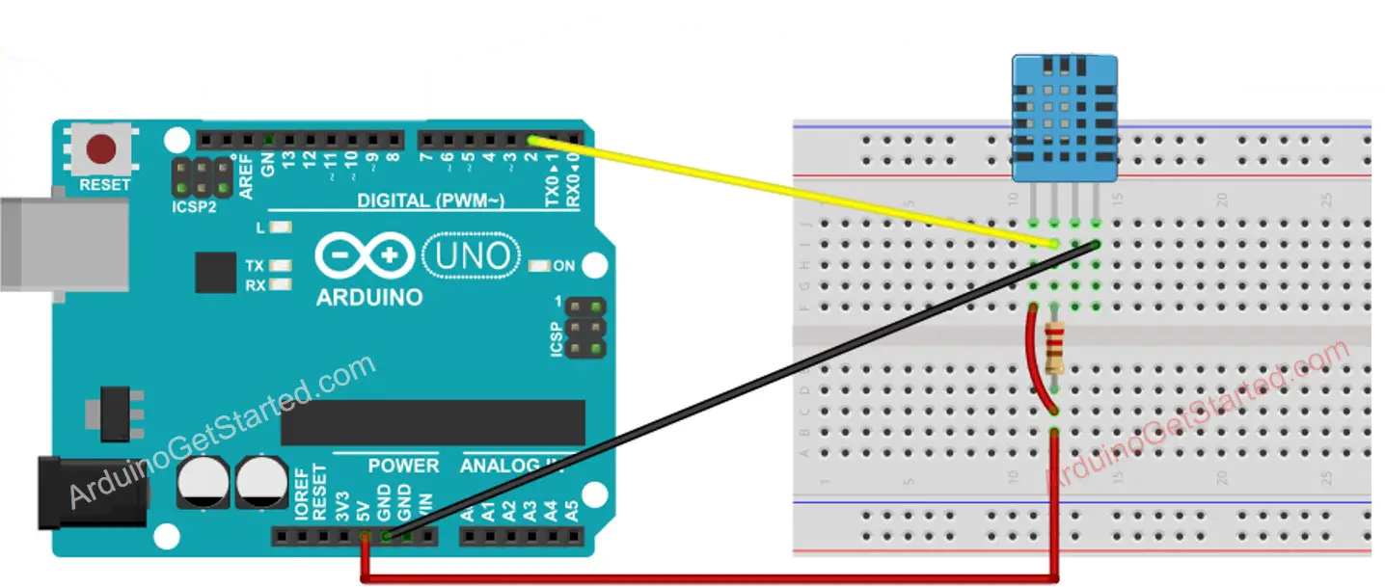
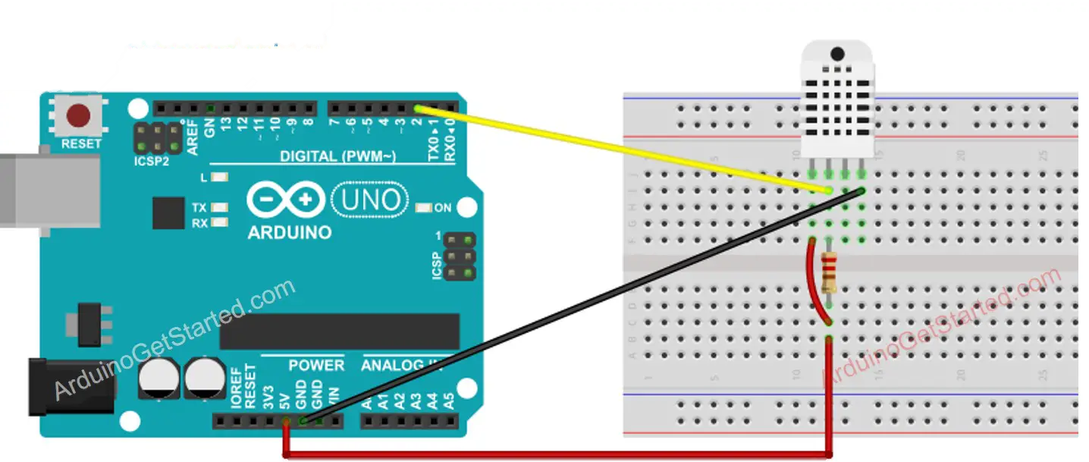
Wiring Diagram
Wiring to Arduino is the same for both sensors . In original form ,A resistor from 5k to 10k Ohms is required to keep the data line high and in order to enable the communication between the sensor and the Arduino
Ardiuno-DHT11 sensor Wiring
Ardiuno-DHT22 Sensor Wiring

Slide 4
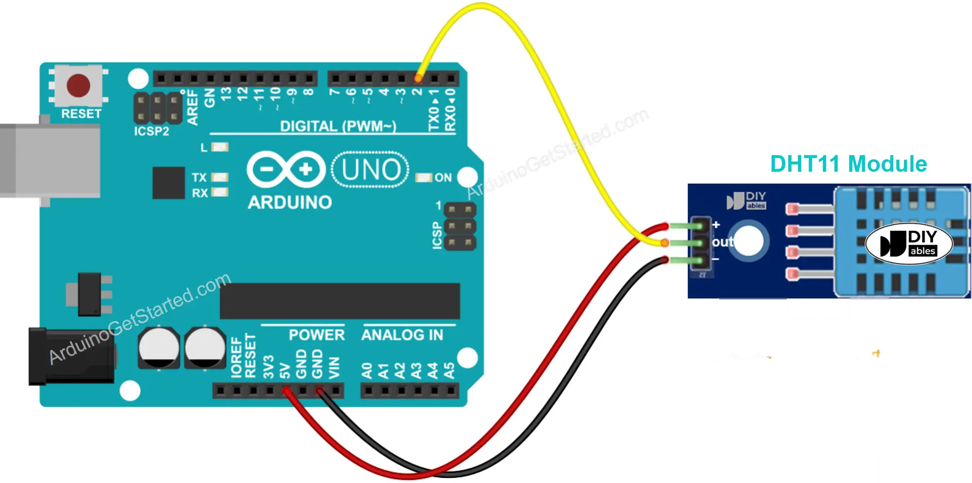
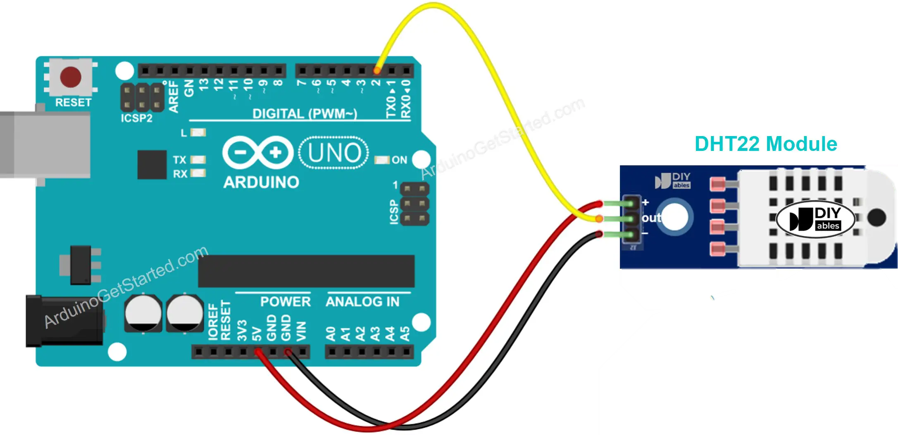
Arduino Module Wiring
Most of sensor modules have a built-in resistor , So you don’t need to add it . It saves us some wiring or soldering works

Slide 5
Arduino Code-DHT11
#include<SimpleDHT.h>
//for DHT11,
//VCC:GND
//DATA:2
int pinDHT11=2;
SimpleDHT11 dht11(pinDHT11);
void setup()
{
serial.begin(115200);
}
Void loop(){
//star working
serial.println(“Sample DHT11”);

Slide 6
.
//read without samples
byte temperature=0;
byte humidity=0;
Int err=SimpleDHTErrSuccess;
If((err=dht11.read(&temperature,&humidity,NULL))!=SimpleDHTErrSuccess){
Seria;.print(“Sample ok:”);
Seria;.print((int)temperature);
Serial.print(“”*c,”);
Serial.print((int)humidity);
Serial.println(“H”);
//DHT11 sampling rate is 1HZ
Delay(1500);
}

Slide 7
.
import serial
Import time
Ser=serial.serial(‘COMS’,115200,timeout=1)
Time.sleep(2)
For I in range(600);
line=ser.readline().decode(“utf-8”)
print(line)
if int(line)>33:
print(“Temperature is too high”);

Slide 8
Arduino Code-DHT22
#include "DHT.h"
#define DHTPIN 2
#define DHTTYPE DHT22
DHT dht(DHTPIN, DHTTYPE);
void setup() {
Serial.begin(9600);
dht.begin(); // initialize the sensor}
void loop() {
// wait a few seconds between measurements.
delay(2000);
// read humidity
float humi = dht.readHumidity();
// read temperature as Celsius
float tempC = dht.readTemperature();
// read temperature as Fahrenheit
float tempF = dht.readTemperature(true);
}

Slide 9
.
// check if any reads failed
if (isnan(humi) || isnan(tempC) || isnan(tempF)) {
Serial.println("Failed to read from DHT sensor!");
} else {
Serial.print("Humidity: ");
Serial.print(humi);
Serial.print("%");
Serial.print(" | ");
Serial.print("Temperature: ");
Serial.print(tempC);
Serial.print("°C ~ ");
Serial.print(tempF);
Serial.println("°F");
}

